Slide 1
RIP version 1
Routing Protocols and Concepts – Chapter 5

Slide 2
Objectives
Describe the functions, characteristics, and operation of the RIPv1 protocol.
Configure a device for using RIPv1.
Verify proper RIPv1 operation.
Describe how RIPv1 performs automatic summarization.
Configure, verify, and troubleshoot default routes propagated in a routed network implementing RIPv1.
Use recommended techniques to solve problems related to RIPv1.

Slide 3
RIPv1
RIP Characteristics
  A classful, Distance Vector (DV) routing protocol
  Metric = hop count
  Routes with a hop count > 15 are unreachable
  Updates are broadcast every 30 seconds

Slide 4
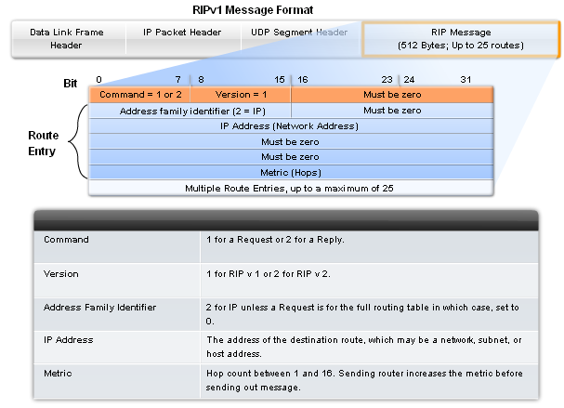
RIPv1
RIP Message Format
RIP header - divided into 3 fields
  Command field
  Version field
  Must be zero
Route Entry - composed of 3 fields
  Address family identifier
  IP address
  Metric

Slide 5
RIPv1
RIP Operation
  RIP uses 2 message types:
    Request message
      This is sent out on startup by each RIP enabled interface
      Requests all RIP enabled neighbors to send routing table
    Response message
      Message sent to requesting router containing routing table

Slide 6
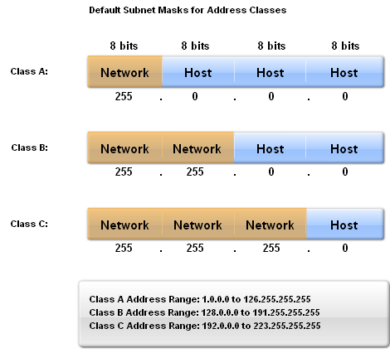
RIPv1
IP addresses initially divided into classes
  Class A
  Class B
  Class C
RIP is a classful routing protocol
  Does not send subnet masks in routing updates

Slide 7
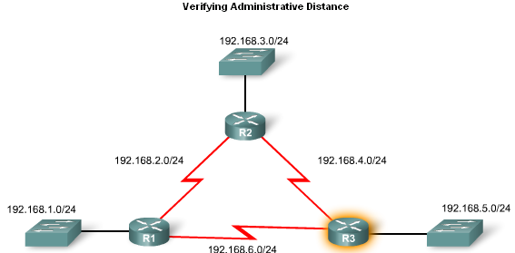
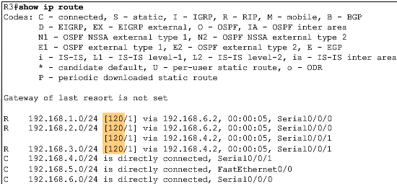
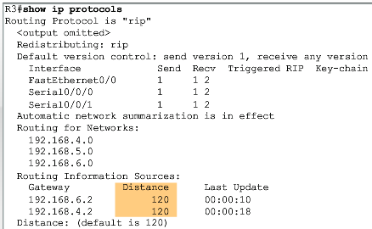
RIPv1
Administrative Distance
  RIP’s default administrative distance is 120

Slide 8
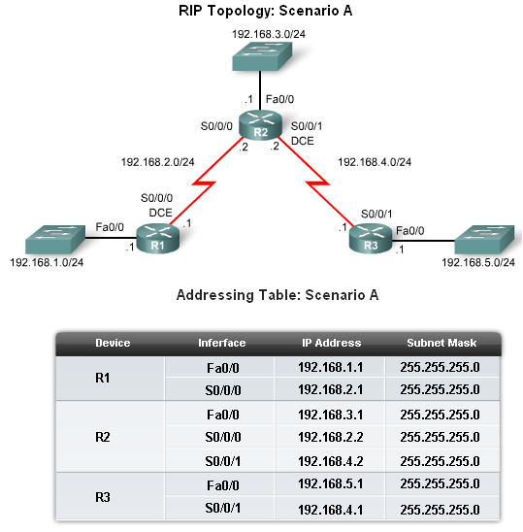
Basic RIPv1 Configuration
A typical topology suitable for use by RIPv1 includes:
  Three router set up
  No PCs attached to LANs
  Use of 5 different IP subnets

Slide 9
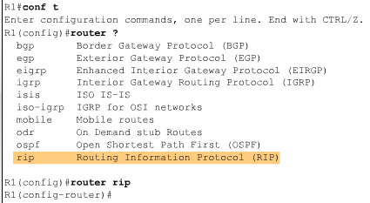
Basic RIPv1 Configuration
Router RIP Command
  To enable RIP enter:
    Router rip at the global configuration prompt
    Prompt will look like R1(config-router)#

Slide 10
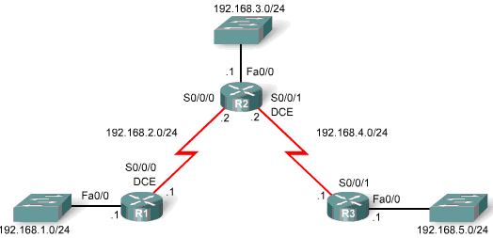
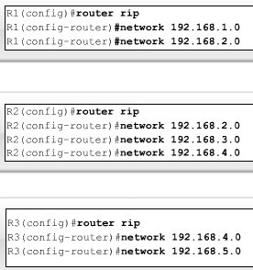
Basic RIPv1 Configuration
Specifying Networks
  Use the network command to:
    Enable RIP on all interfaces that belong to this network
    Advertise this network in RIP updates sent to other routers every 30 seconds

Slide 11
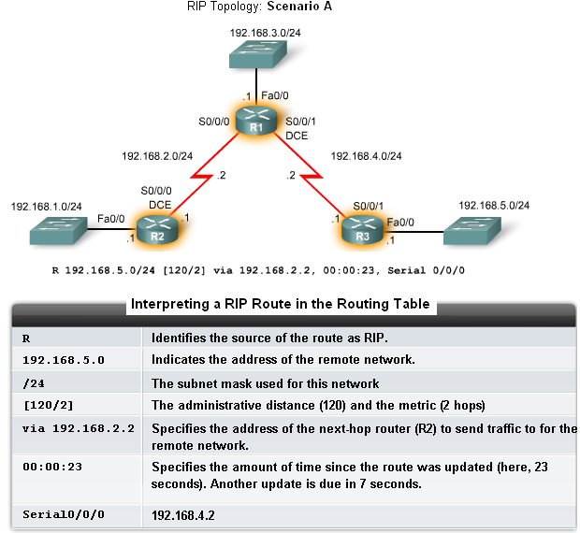
Verification and Troubleshooting
Show ip Route
To verify and troubleshoot routing
  Use the following commands:
    show ip route
    show ip protocols
    debug ip rip

Slide 12
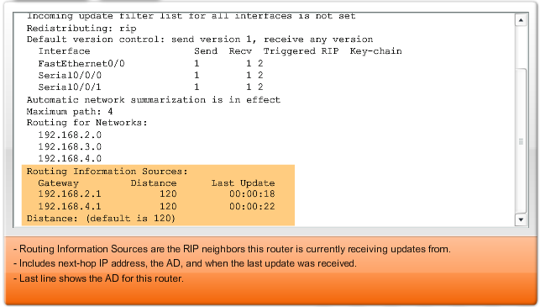
Verification and Troubleshooting
show ip protocols command
  Displays routing protocol configured on router

Slide 13
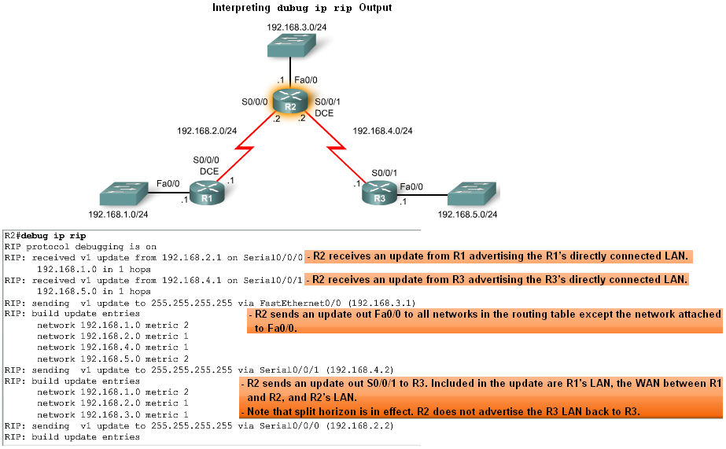
Verification and Troubleshooting
Debug ip rip command
  Used to display RIP routing updates as they are happening

Slide 14
Verification and Troubleshooting
Passive interface command
  Used to prevent a router from sending updates through an interface
  Example:
    Router(config-router)#passive-interface interface-type interface-number

Slide 15
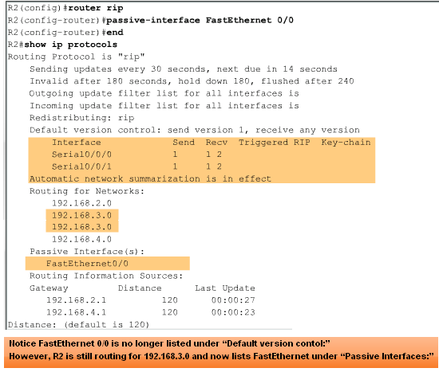
Verification and Troubleshooting
Passive interfaces

Slide 16
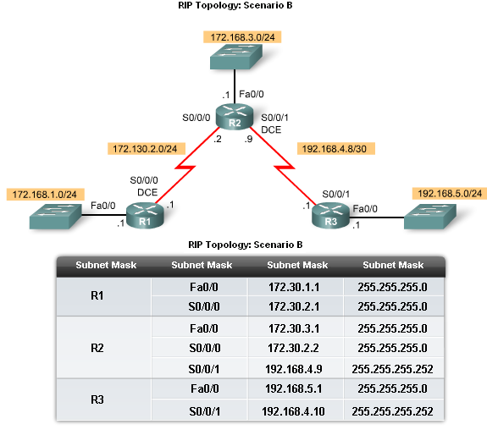
Automatic Summarization
Modified Topology
The original scenario has been modified such that:
  Three classful networks are used:
    172.30.0.0/16
    192.168.4.0/24
    192.168.5.0/24
  The 172.30.0.0/16 network is subnetted into three subnets:
    172.30.1.0/24
    172.30.2.0/24
    172.30.3.0/24
  The following devices are part of the 172.30.0.0/16 classful network address:
    All interfaces on R1
    S0/0/0 and Fa0/0 on R2

Slide 17
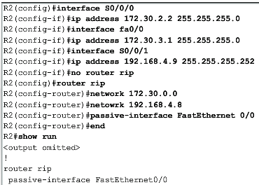
Automatic Summarization
Configuration Details
  To remove the RIP routing process use the following command
    No router rip
  To check the configuration use the following command
    Show run

Slide 18
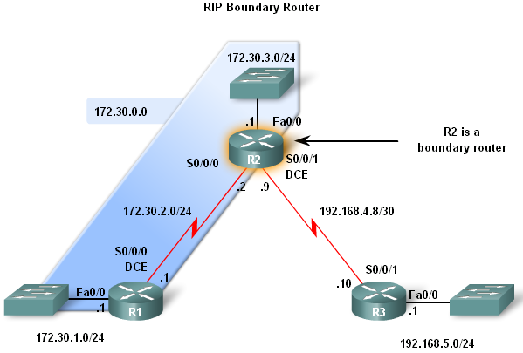
Automatic Summarization
Boundary Routers
  RIP automatically summarizes classful networks
  Boundary routers summarize RIP subnets from one major network to another

Slide 19
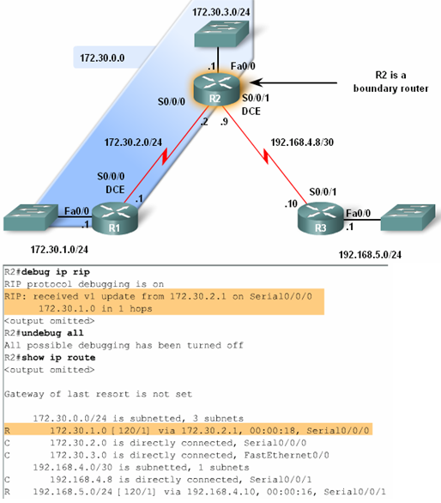
Automatic Summarization
Processing RIP Updates
2 rules govern RIPv1 updates:
  If a routing update and the interface it’s received on belong to the same network then
    The subnet mask of the interface is applied to the network in the routing update
  If a routing update and the interface it’s received on belong to a different network then
    The classful subnet mask of the network is applied to the network in the routing update

Slide 20
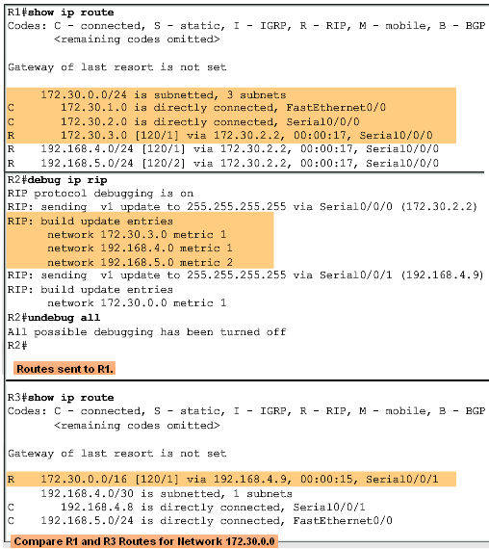
Automatic Summarization
Sending RIP Updates
  RIP uses automatic summarization to reduce the size of a routing table

Slide 21
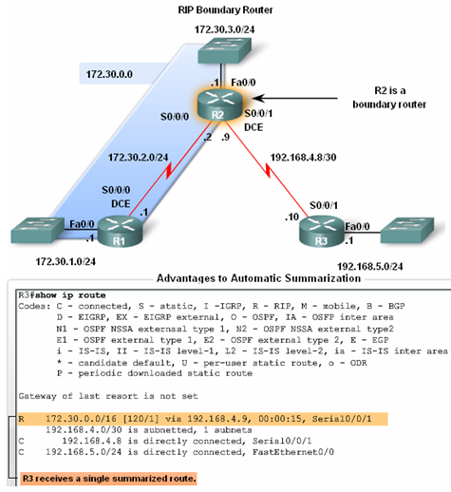
Automatic Summarization
Advantages of automatic summarization:
  The size of routing updates is reduced
  Single routes are used to represent multiple routes which results in faster lookup in the routing table

Slide 22
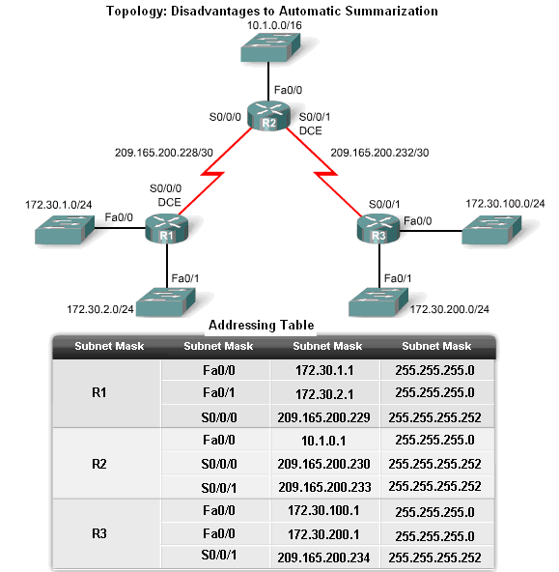
Automatic Summarization
Disadvantage of Automatic Summarization:
  Does not support discontiguous networks

Slide 23
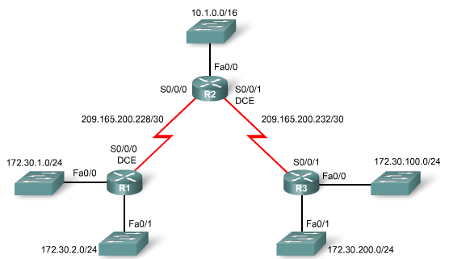
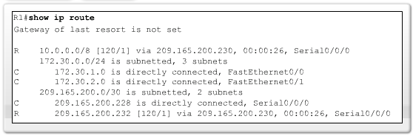
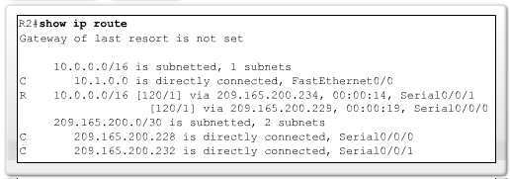
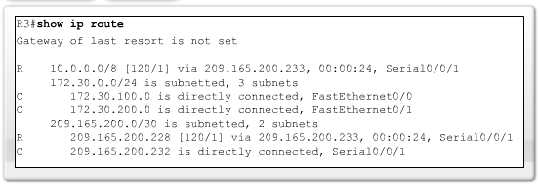
Automatic Summarization
Discontiguous Topologies do not converge with RIPv1
A router will only advertise major network addresses out interfaces that do not belong to the advertised route

Slide 24
Default Route and RIPv1
Modified Topology: Scenario C
Default routes
  Packets that are not defined specifically in a routing table will go to the specified interface for the default route
  Example: Customer routers use default routes to connect to an ISP router
  Command used to configure a default route is ip route 0.0.0.0 0.0.0.0 s0/0/1

Slide 25
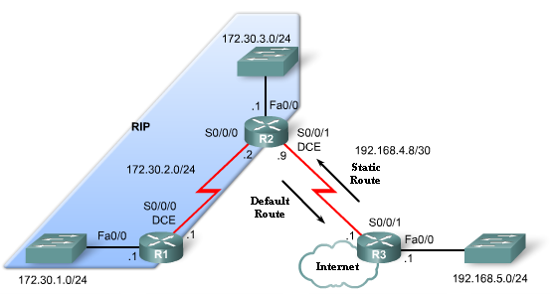
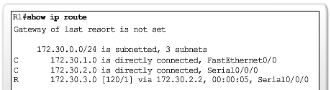
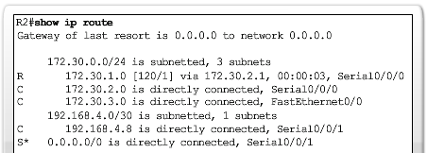
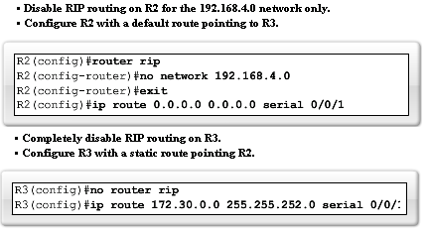
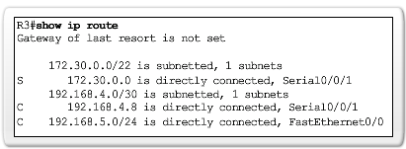
Default Route and RIPv1

Slide 26
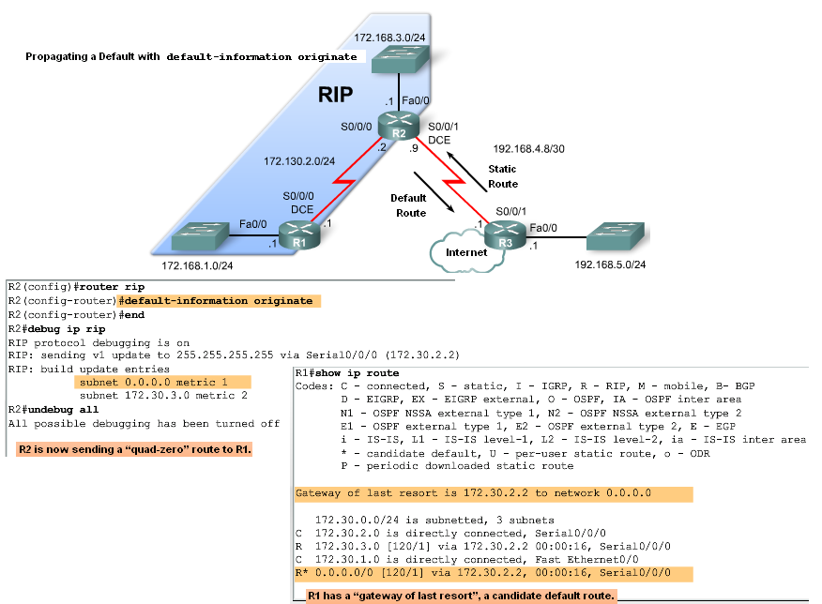
Default Route and RIPv1
Propagating the Default Route in RIPv1
Default-information originate command
  This command is used to specify that the router is to originate default information, by propagating the static default route in RIP update

Slide 27
Summary
RIP characteristics include:
  Classful, distance vector routing protocol
  Metric is Hop Count
  Does not support VLSM or discontiguous subnets
  Updates every 30 seconds
Rip messages are encapsulated in a UDP segment with source and destination ports of 520

Slide 28
Summary: Commands used by RIP
Command | Command’s purpose
Rtr(config)#router rip | Enables RIP routing process
Rtr(config-router)#network | Associates a network with a RIP routing process
Rtr#debug ip rip | used to view real time RIP routing updates
Rtr(config-router)#passive-interface fa0/0 | Prevent RIP updates from going out an interface
Rtr(config-router)#default-information originate | Used by RIP to propagate default routes
Rtr#show ip protocols | Used to display timers used by RIP

